Slide 1
MCTS Guide to Microsoft Windows 7
Chapter 13
Enterprise Computing

Slide 2
Objectives
Understand Active Directory
Use Group Policy to control Windows 7
Control device installation with Group Policy settings
Plan enterprise deployments of Windows 7
Describe enterprise deployment tools for Windows 7
Use Windows Server Update Services to apply updates
Understand Network Access Protection

Slide 3
Active Directory
Active Directory
Expands domain concept by linking:
Domains in logical structures named trees
Multiple trees into forests
Domain controllers
Servers holding a copy of Active Directory information
Authenticate users when they log on to a workstation
Respond to requests for other domain information such as printer information or application configuration

Slide 4
Active Directory Structure
Domain
Central security database used by all computers that are members of the domain
Information about user accounts and computers
Active Directory uses the same naming convention for domains and objects as DNS
Organizational Units (OUs)
Each domain can be subdivided into OUs
Allow you to organize the objects in a domain
Can be used for delegating management permissions

Slide 5
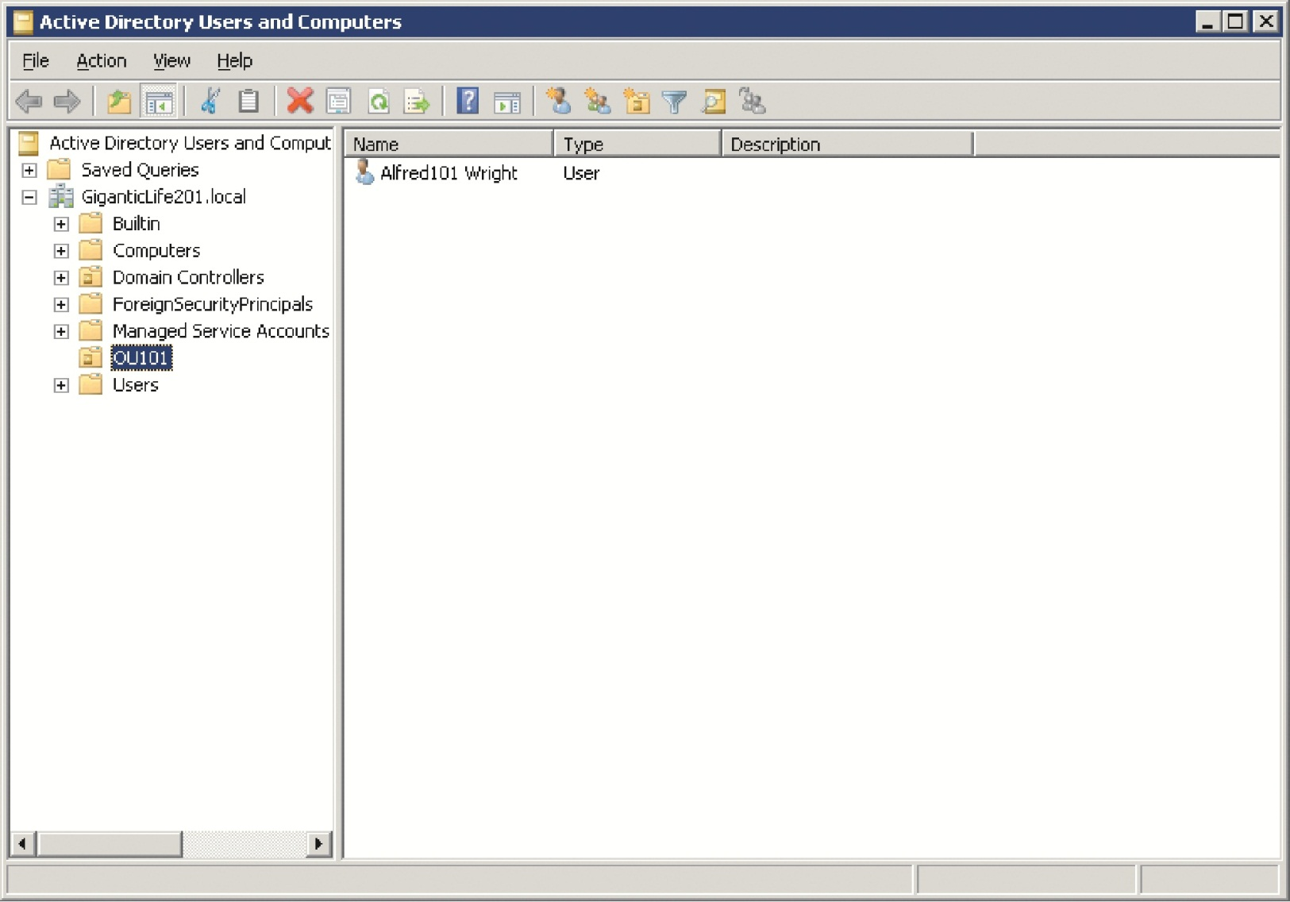
Active Directory Structure (cont'd.)

Slide 6
Active Directory Structure (cont'd.)
Organizational Units (OUs) (cont'd.)
Used to apply Group Policies
Trees and Forests
Create more complex Active Directory structures by combining multiple domains into a tree
And multiple trees into a forest
Reasons to use multiple domains
Decentralized administration
Unreliable WAN links
Multiple password policies

Slide 7
Active Directory Structure (cont'd.)
Trees and Forests (cont'd.)
Forest root domain
First Active Directory domain created in an organization
When multiple domains exist in a forest
Trust relationships are generated automatically between the domains
In a forest, each domain trusts its own parent and subdomains

Slide 8
Active Directory Structure (cont'd.)

Slide 9
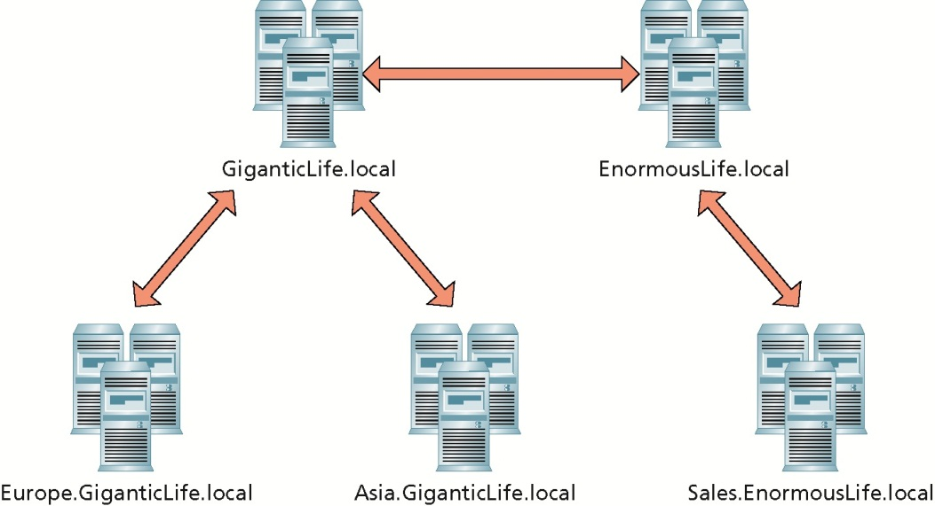
Active Directory Structure (cont'd.)

Slide 10
Active Directory Structure (cont'd.)
Server Roles
Within Active Directory
Windows servers can be either a member server or a domain controller
Member servers are integrated into Active Directory
Can participate in the domain by sharing files and printers with domain users
Domain controller is a server that stores a copy of Active Directory information

Slide 11
Active Directory Partitions
Active Directory divided into manageable units
Domain partition
User accounts, computers accounts, and other domain-specific information
Configuration partition
General information about the Active Directory forest
Schema partition
Definitions of all objects and attributes for the forest
Application partitions can be created by an administrator to hold application-specific information
Global catalog server
Domain controller that holds a subset of the information in all domain partitions

Slide 12
Active Directory Sites and Replication
Active Directory uses multimaster replication
Active Directory information can be changed on any domain controller
Changes are replicated to other domain controllers
Active Directory site is defined by IP subnets
Within a site, Active Directory replication is uncontrolled
Between sites, Active Directory replication is controlled by site links

Slide 13
Active Directory Sites and Replication (cont’d.)
Active Directory and DNS
One of the most common configuration problems in Active Directory networks
Incorrect DNS configuration on servers and workstations
Active Directory stores information about domain controllers and other services in DNS
Incorrect DNS configuration can result in:
Slow user logons
Inability to apply group policies
Failed replication between domain controllers

Slide 14
Joining a Domain
When a workstation joins a domain
Integrated into the security structure for the domain
Administration can be done centrally using Group Policy
Security changes:
Domain Admins group becomes a member of the local Administrators group
Domain Users group becomes a member of the local Users group
Domain Guests group becomes a member of the local Guests group

Slide 15
Joining a Domain (cont'd.)
Joining a workstation to a domain creates a computer account
After a workstation is joined to the domain
It synchronizes time with domain controllers in the domain

Slide 16
Group Policy
Group Policy
Centrally manage the configuration of a Windows 7 computer
Settings you can configure
Desktop settings, such as wallpaper and the ability to right-click
Security settings, such as the ability to log on locally
Logon, logoff, startup, and shutdown scripts
Folder redirection to store My Documents on a network server
Software distribution

Slide 17
Group Policy (cont'd.)
Group Policy settings used by Windows 7 are contained in a Group Policy object (GPO)
Group Policy object (GPO)
Collection of registry settings applied to the Windows 7 computer
Settings in a GPO are divided into user settings and computer settings
User settings are applied to any user accounts in OU
Computer settings in the GPO are applied to any computer accounts in OU

Slide 18
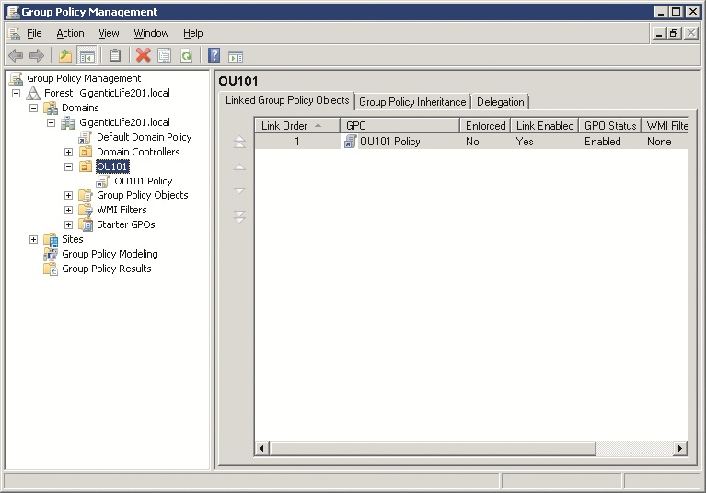
Group Policy (cont'd.)

Slide 19
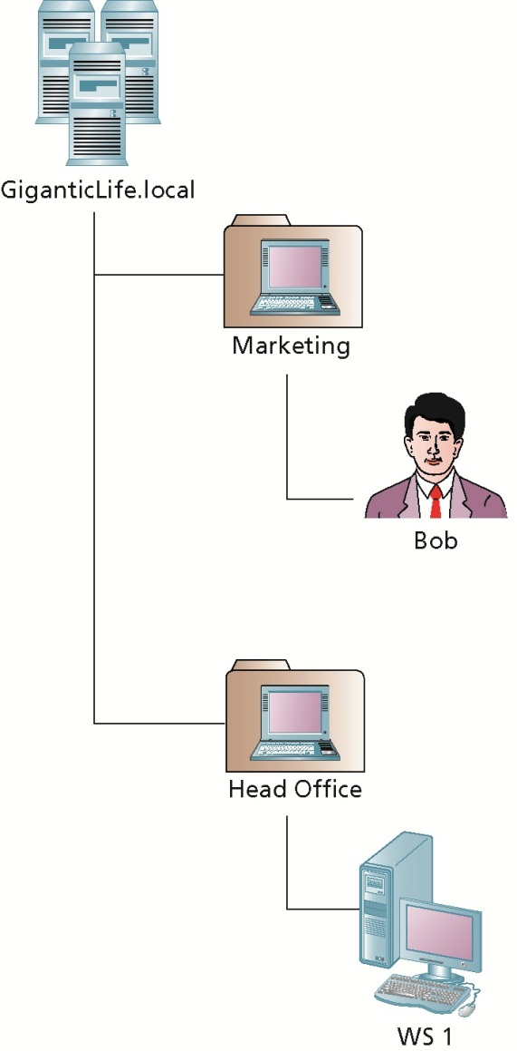
Group Policy (cont'd.)

Slide 20
Group Policy Inheritance
Group Policy objects can be linked to the Active Directory domains, OUs, and Active Directory sites
Each Windows 7 Computer can have local Group Policy objects
GPOs are applied in the following order:
Local computer
Site
Domain
Parent OU
Child OU

Slide 21
Group Policy Inheritance (cont'd.)
All individual GPO settings are inherited by default
At each level, more than one GPO can be applied to a user or computer
Determining which policy settings to apply
If no conflict, the settings for all policies are applied
If a conflict, later settings overwrite earlier settings
If the settings in a computer policy and user policy conflict, apply settings from the computer policy

Slide 22
Group Policy Enhancements in Windows 7
Group Policy Service
Windows 7 processes group policies with a new Group Policy service
Benefits
Group Policy settings can be applied without reboots
Performance is increased and resource usage is reduced for Group Policy processing
Group Policy events are logged to the System log instead of the Application log
Information about Group Policy applications is logged to a Group Policy Operational log

Slide 23
Group Policy Enhancements in Windows 7 (cont'd.)
Group Policy Preferences
Introduce a way to configure a number of Windows 7 features that may have required scripting in the past
Multiple Local Policies
Windows 7 allows you to have multiple local GPOs
Distinct settings for different users, even in a workgroup

Slide 24
Controlling Device Installation
You can prevent device installation in Windows 7
Example:
Prevent installation of USB-based storage to prevent data from leaving the premises

Slide 25
Device Identification
Windows 7 uses a device identification string and device setup class
To properly install a new device
Device Identification Strings
Device reports multiple device identification strings
Hardware ID is the most specific device identification string
Multiple hardware IDs allow the best available driver to be installed
Compatible IDs are another device identification string that is used to find appropriate drivers

Slide 26
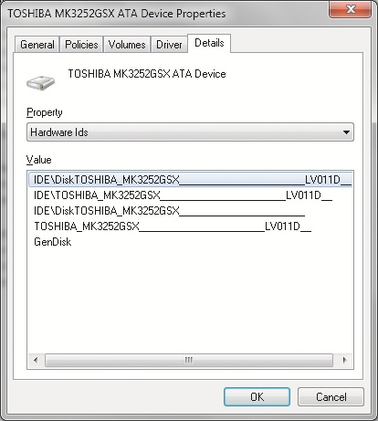
Device Identification (cont'd.)

Slide 27
Device Identification (cont’d.)
Device setup classes
Used during the installation process for a new device to describe how the installation should be performed
Identify a generic type of device rather than a specific make or model
Some devices have multiple GUIDs defined if they are a multifunction device

Slide 28
Device Installation Group Policy Settings
Windows 7 includes ten group policy settings
Specifically to control device installation
Group Policy settings that control device installation
Allow administrators to override Device Installation Restriction policies
Allow installation of devices using drivers that match these device setup classes
Prevent installation of devices using drivers that match these device setup classes

Slide 29
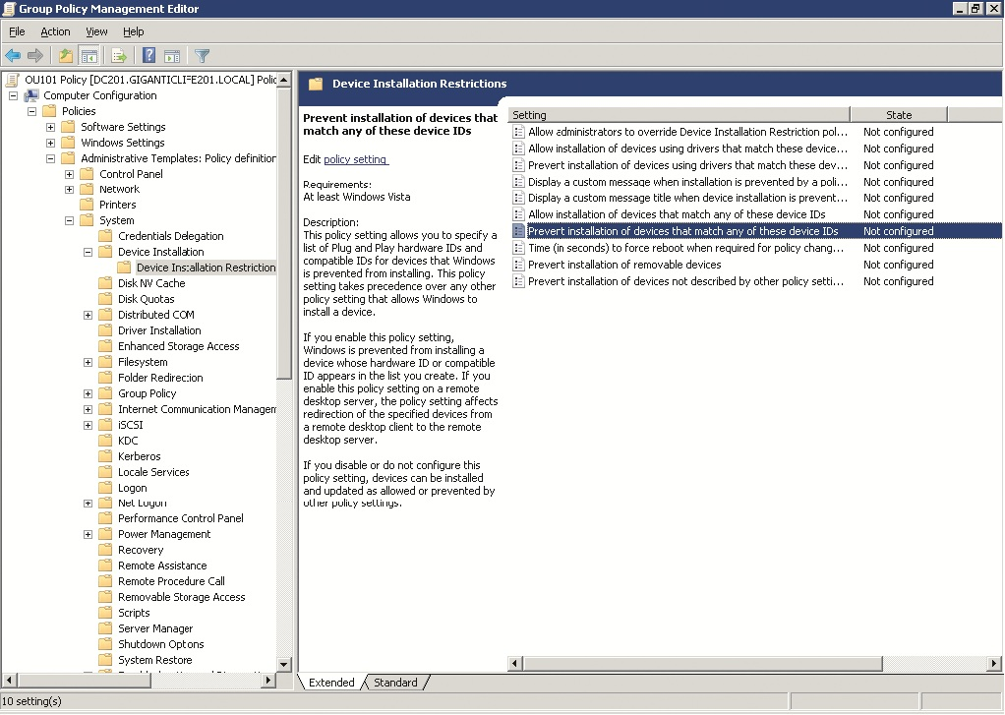
Device Installation Group Policy Settings (cont'd.)

Slide 30
Device Installation Group Policy Settings (cont'd.)
Group Policy settings that control device installation (cont'd.)
Display a custom message when installation is prevented by a policy setting
Display a custom message title when device installation is prevented by a policy setting
Allow installation of devices that match any of these device IDs
Prevent installation of devices that match any of these device IDs
Time (in seconds) to force reboot when required for policy changes to take effect
Prevent installation of removable devices
Prevent installation of devices not described by other policy settings

Slide 31
Removable Storage Group Policy Settings
Additional Group Policy settings
Control access to removable storage
Types of devices you can control
CD and DVD
Custom Classes
Floppy Drives
Removable Disks
All Removable Storage classes
Tape Drives
Windows Portable Devices (WPD)
All Removable Storage classes

Slide 32
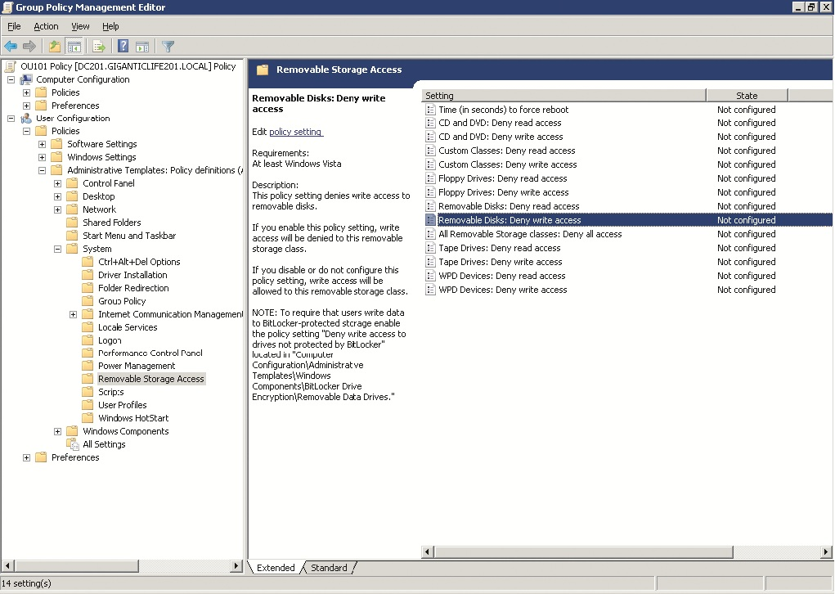
Removable Storage Group Policy Settings (cont'd.)

Slide 33
Deployment Planning
Formal process for implementing Windows 7 should include the following steps:
Define the scope and goals of the project
Assess the existing computer systems
Plan the new computer system configuration
Determine a deployment process
Test the deployment process
Deploy Windows 7

Slide 34
Scope and Goals
Organizations should not change computer systems for the sake of change
Must be significant benefits to the organization
Scope for a Windows 7 migration project defines which computers should be upgraded
Also defines the data to be migrated

Slide 35
Existing Computer Systems
Existing computer systems in the organization must be evaluated
To ensure that they support Windows 7
Evaluation is composed of two parts
Hardware evaluation
Software evaluation

Slide 36
New Configuration
In some cases, the default configuration of Windows 7 is sufficient for organizational need
In many more cases, the organization customizes the default configuration of Windows 7
To match its needs
Applications must also be selected as part of the configuration planning

Slide 37
Deployment Process Selection
Can either upgrade existing operating system or do a clean installation
Upgrade retains all existing computer settings
User files, applications, and application settings
Clean installation allows standardized configuration
Rather than using existing settings

Slide 38
Deployment Process Selection (cont'd.)
Potential installation methods
Boot from DVD
Run unattended setup from a network share or DVD
Imaging
Windows Deployment Services
Systems Management Server

Slide 39
Test Deployment
You must thoroughly test the deployment process
First part of testing should be in a test lab
Then, perform a test pilot to designated users within the organization
Users and computers selected should be representative of the users and computers in the overall organization

Slide 40
Deployment
In most cases, deployment:
Will not be over a single night or a single weekend
Will be by department, region, building, or floor
Breaking deployment into smaller phases reduces the risk of failure

Slide 41
Enterprise Deployment Tools
Many tools are available to help in the deployment of Windows 7
ImageX, Sysprep, Windows System Image Manager (WSIM), Windows PE, and Windows Easy Transfer
Additional tools
User State Migration Tool (USMT) and Windows Deployment Services (WDS)
System Center Configuration Manager (SCCM) and the Microsoft Deployment Toolkit (MDT)
VHD boot

Slide 42
User State Migration Tool
USMT
Similar to Windows Easy Transfer
Migrates user settings, documents, and application configuration settings
Command-line interface and a graphical interface
Configuration of USMT is done by editing XML files
MigApp.xml, MigUser.xml, MigSys.xml, Config.xml

Slide 43
User State Migration Tool (cont'd.)
USMT Migration Process
Steps
Use ScanState on the source computer to collect settings and files
Install Windows 7 on the destination computer
Use LoadState on the destination computer to import settings and files
When ScanState is used to collect settings and files, they are stored in an intermediate location
All applications should be installed on the destination computer before LoadState is used

Slide 44
User State Migration Tool (cont'd.)

Slide 45
User State Migration Tool (cont'd.)
Using Config.xml
Generated by running ScanState.exe with the /genconfig option
Captures all of the settings that are being migrated
You can edit this file to control which of the settings are actually migrated when ScanState.exe is run
You can use multiple Config.xml files
To control the migration process in different ways for users with different needs

Slide 46
Windows Deployment Services
Windows Deployment Services (WDS)
An updated version of the Remote Installation Services (RIS)
Automates the installation of Windows clients
WDS Requirements
Active Directory
DHCP
DNS
An NTFS partition on the WDS server
Windows Server 2003 SP1 with RIS installed
Administrative credentials

Slide 47
Windows Deployment Services (cont'd.)
WDS Image Types
Install image
Boot image
Capture image
Discover image
WDS Deployment Process
Enable PXE in the client computer and configure it to boot from network first
Reboot the workstation and press F12 to perform a PXE boot

Slide 48
Windows Deployment Services (cont'd.)
WDS Deployment Process (cont'd.)
Workstation obtains IP address from DHCP server and contacts WDS server
Select a PXE boot image if required
Boot image is downloaded to a RAM disk on the client computer and Windows PE is booted
Select an install image to deploy from the menu
ImageX runs to deploy the install image

Slide 49
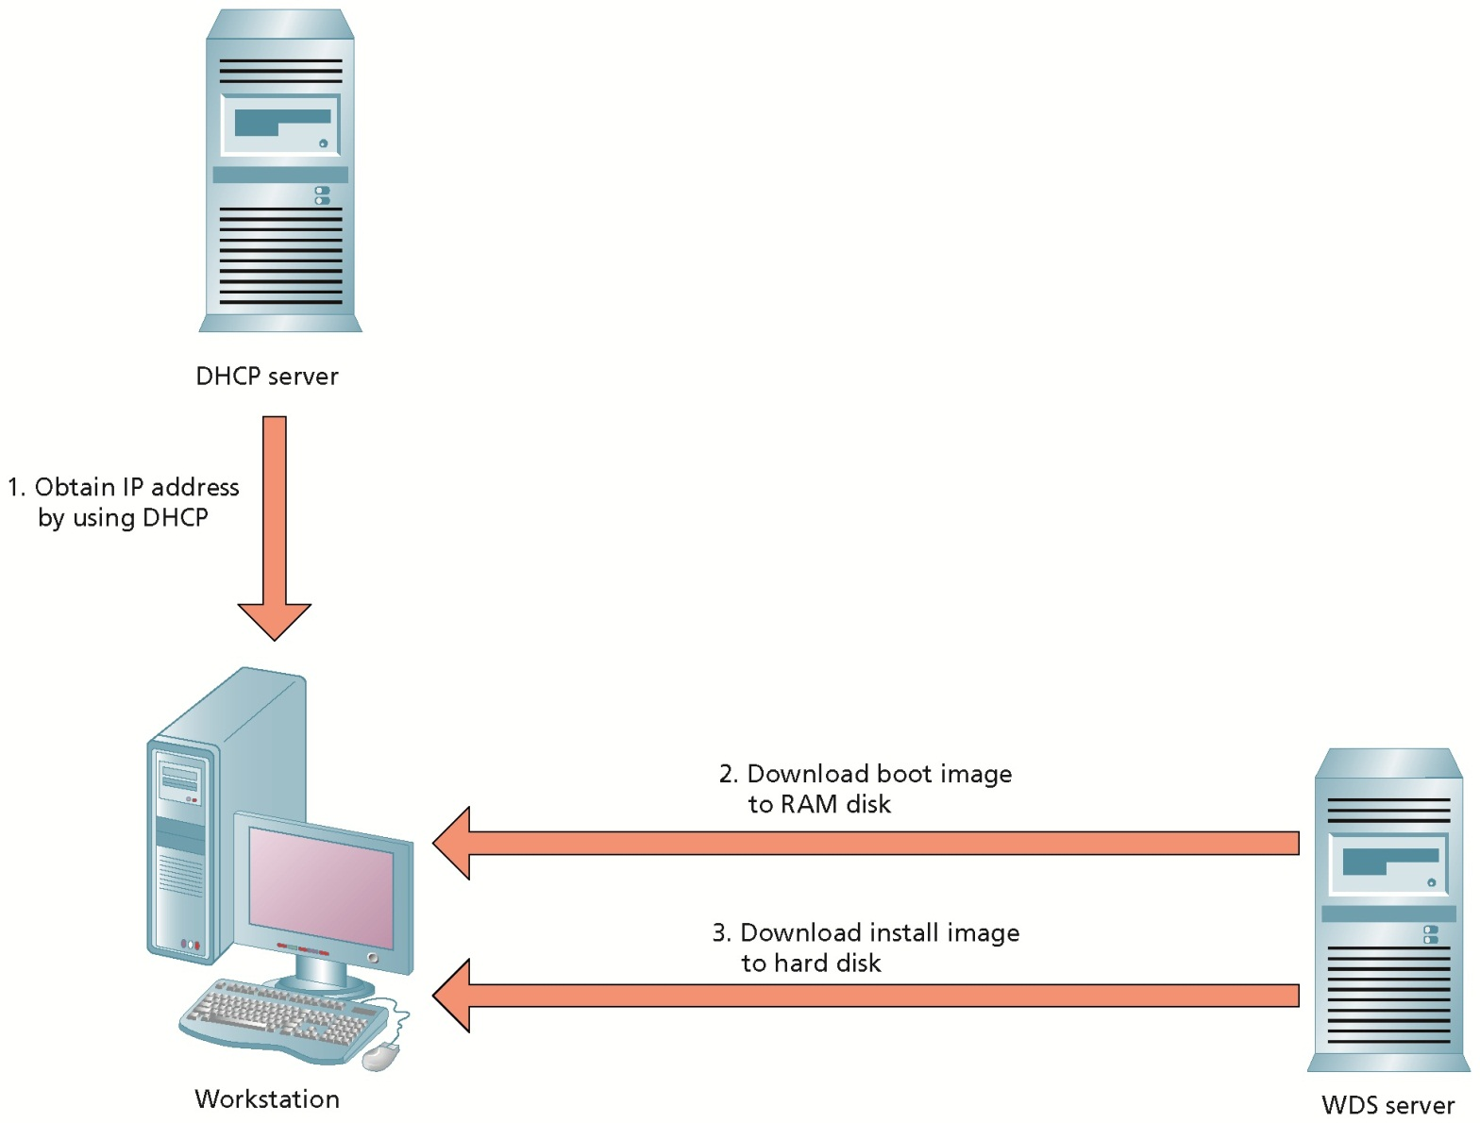
Windows Deployment Services (cont'd.)

Slide 50
System Center Configuration Manager
SCCM is a solution from Microsoft to control the configuration of Windows computers
Main tasks you can accomplish with SCCM:
Inventory
Standardized configuration
Software deployment
Operating system deployment
Software updates

Slide 51
Microsoft Deployment Toolkit
MDT
Helps you configure scripted installations of operating systems and applications
You can use MDT with SCCM or on its own
Also includes a wide range of documentation about the deployment Windows 7

Slide 52
VHD Boot
New feature in Windows 7
Allows the operating system to be installed to and booted from a virtual hard disk (VHD) file instead of a disk partition
Useful for power users in large enterprises with a virtualized desktop environment
VHD boot can also be used to simplify dual booting

Slide 53
Windows Server Update Services
Windows Server Update Services (WSUS) 3.0
Server component
Contacts Microsoft Update and downloads updates
Rather than each client computer downloading updates
Very efficient for network utilization
Each update is downloaded only once and stored on the WSUS server
Client computers are configured to contact a WSUS server for updates

Slide 54
WSUS Update Process
You can organize computers into groups to control the update process
And generate reports to view which computers have been updated and which have not
You can test updates before they are generally applied to workstations
Significantly reduces the risk of an updates causing system down time
WSUS update process still relies on the client computers to trigger the installation of updates
You can configure rules on the WSUS server

Slide 55
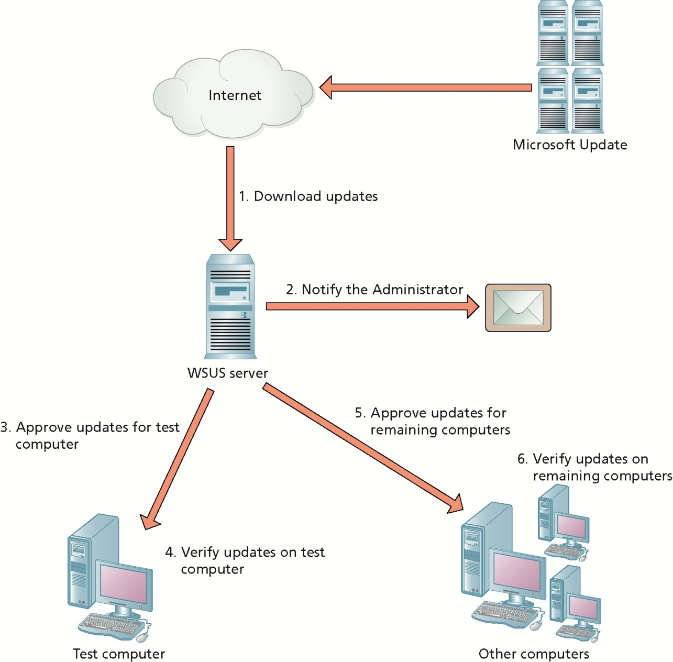
WSUS Update Process (cont'd.)

Slide 56
WSUS Updates
WSUS obtains updates for the following products:
Windows clients and servers (including 64-bit)
Exchange Server
SQL Server
Microsoft Office
Microsoft Data Protection Manager
Microsoft ForeFront
Windows Live
Windows Defender

Slide 57
Network Access Protection
Network Access Protection (NAP)
System that enforces requirements for client health
Before allowing client computers to connect to the network
Client and server components are required for NAP
NAP is not intended to block network intruders or protect the network from malicious users

Slide 58
Enforcements Mechanisms
Enforcement mechanisms integrated with NAP
IPsec
802.1X
VPN
DHCP
RADIUS

Slide 59
Summary
Active Directory is a database of network information about users, computers, and applications
Computers in an Active Directory domain can be either a member server or domain controller
Active Directory is composed of a domain partition, configuration partition, and schema partition
Clients use DNS to locate domain controllers
Group Policy is used to configure and control workstations

Slide 60
Summary (cont'd.)
Group Policy has been enhanced in Windows 7
Use Group Policy settings to control device installation and use of removable storage devices
Deploying Windows 7 in an enterprise requires a formal planning process
USMT has a command-line interface that is appropriate for scripting in large scale deployments
WDS is used to apply images to workstations with minimal user intervention

Slide 61
Summary (cont'd.)
SCCM is a software package that can perform inventory, implement a standardized configuration, deploy software, deploy operating systems, and deploy software updates
MDT can be used to configure automated installations of Windows 7
WSUS downloads updates from Microsoft Update and controls their application to Windows clients
NAP is a feature in both Windows “Longhorn” Server and Windows 7

